Slide 1
Triangle Real Estate
Amelia, Brandi, Catina, David, Kurt

Slide 2
Executive Summary
We will continue working with real estate data from the Multiple Listing Service (MLS), focusing on building a predictive model to accurately estimate home sale prices. We will leverage Gradient Boosting Machines (GBM) and Natural Language Processing (NLP) techniques to enhance the model's performance.

Slide 3
Project Approach
Our team’s goal was to produce two deliverables:
A regression model for predicting the sale price of a home
An NLP model which assesses mortgage rate sentiment from news articles
For the regression model:
4 years of housing data were collected from the MLS
Data was cleaned and engineered to produce necessary features
Multiple regression models were researched and tested in order to determine the best model for price prediction. These included Random Forest, XGBoost, CatBoost, and LightGBM
For the NLP model:
BERT (Bidirectional Encoder Representations from Transformers) and VADER ( Valence Aware Dictionary for Sentiment Reasoning) models utilized
Total Articles Analyzed: 10,000+
Time Range:
January 2019 to December 2019, General News Articles
Sources: 20 different news outlets
Categories: Various topics including politics, crime, business, and technology
January 2022 to July 2024, New York Times Articles API based on the following keywords: Real Estate, Federal Reserve, Interest Rates, Home Selling
Initial goal to utilize only articles selected based on keywords, encountered API limits requiring the use of general news articles available for public use.
Notes:
David

Slide 4
Regression:
Data Engineering
Notes:
Catina

Slide 5
Data Engineering
Four years worth of real estate data were collected from the MLS, including features such as Address, City, Zip, Beds, Baths, Sqft, Acres, etc.
Only single-family homes were utilized, and only cities which contained 1000 or more data points
Primarily null columns were removed (subdivision, neighborhood), along with any rows containing features whose values fell outside 3 standard deviations of the mean
Using a python library, addresses were converted to lat and lon coordinates
Data was scaled to make it suitable for the models
Cities were one-hot encoded to handle categorical aspects
Notes:
David

Slide 6
Data Engineering
Because neither latitude nor longitude by themselves have a direct effect on the sale price of the home, we needed a way to combine these two features
Multiple methods for combining lat and lon data were researched, such as euclidean scalars, geohashing, and embedding
It was decided to create a deep learning neural network, from which spatial features could be extracted from the dense layers, and plugged back into the regression models using a hybrid approach
32 spatial features were generated from the NN and plugged back into the data to be used for the regressor models
Notes:
David

Slide 7
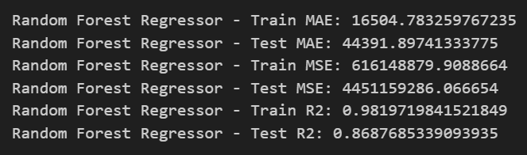
Data Engineering
Interestingly, the best results from the Random Forest model were obtained when utilizing both the Lat/Lon and embedded spatial data. Choosing only one of the two options resulted in lower scores.
By using this embedded approach alongside the Lat and Lon, we were able to significantly improve on the results from our last project
Because tree-based models like Random Forest and XGBoost handle redundant data well, leaving both sets of features in the data proved to be beneficial
Notes:
David

Slide 8
Regression:
CatBoost Modules
Notes:
Catina

Slide 9
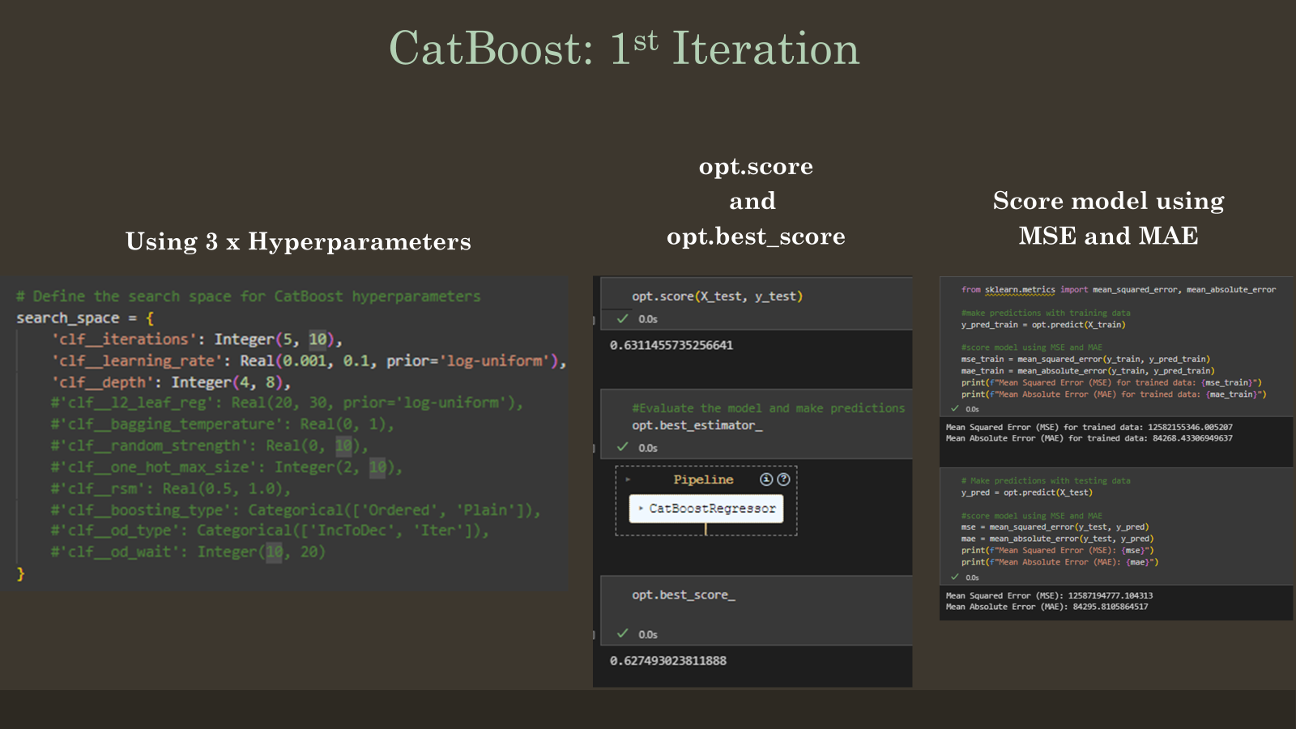

Slide 10
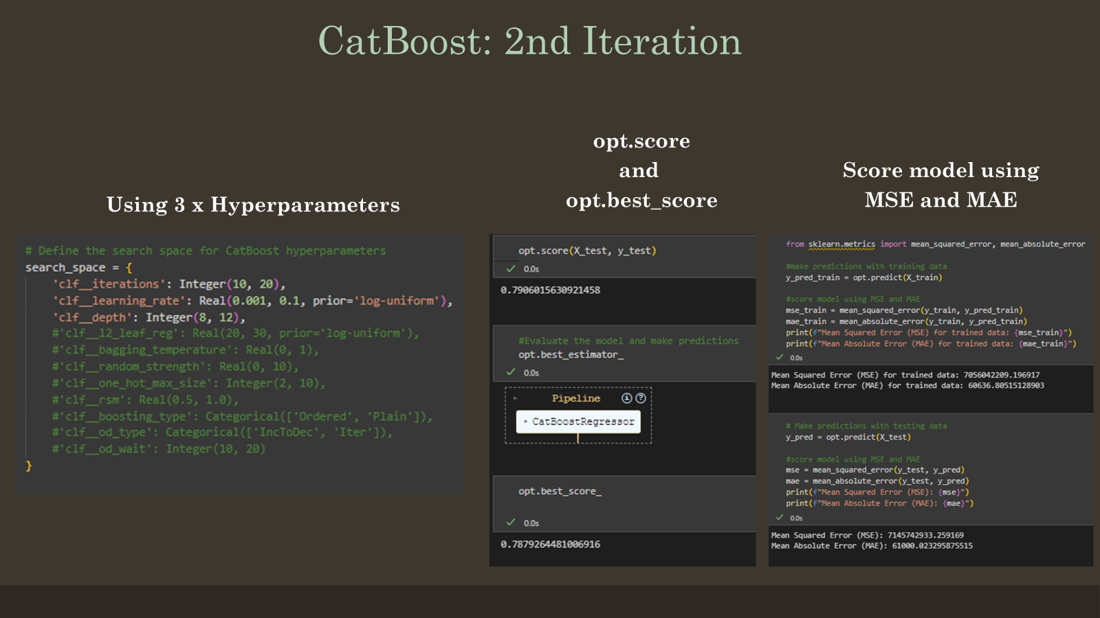

Slide 11
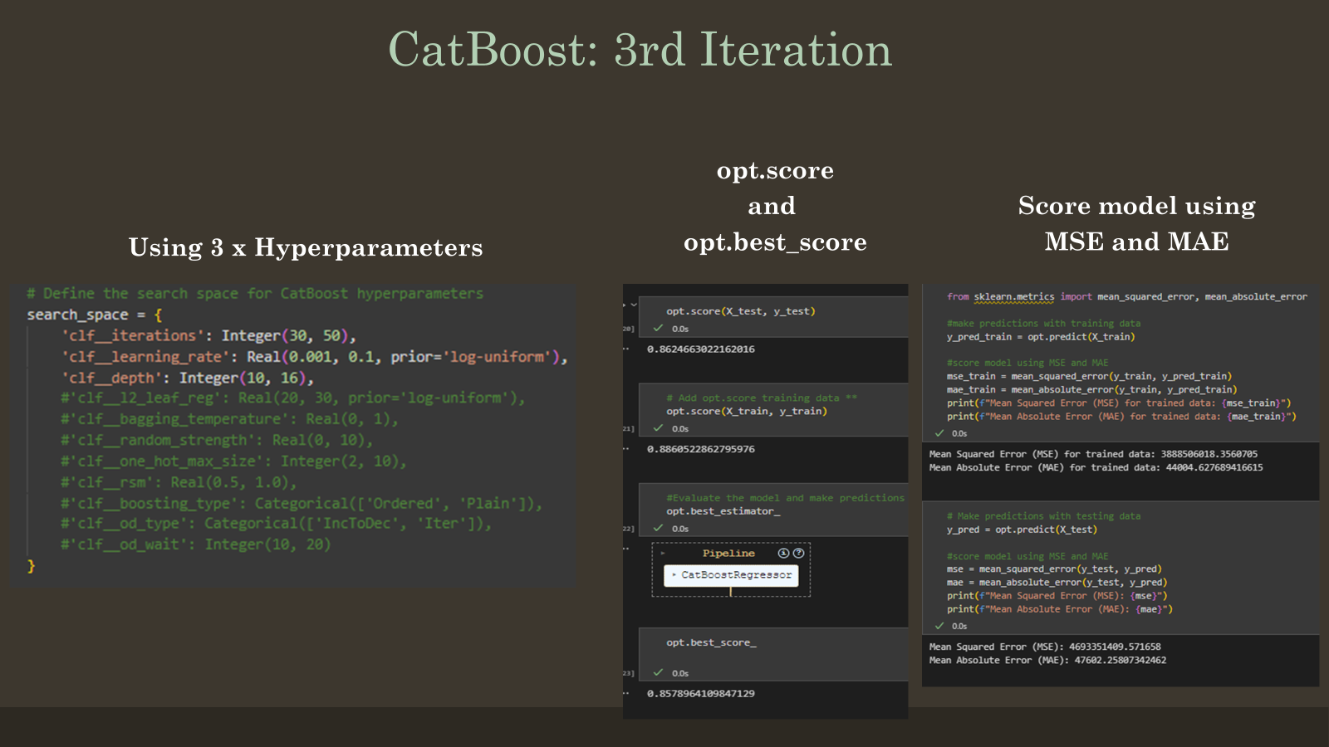

Slide 12
Regression:
XG Boost Modules
Notes:
Amelia

Slide 13
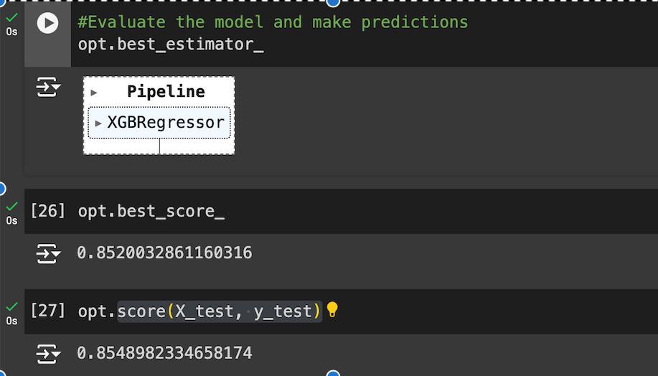
XGBoost 1st round:
Bayes Search CV(cv=8, n_iter=20, scoring=neg_mean_squared_error)
Nine parameters are used here.
No predictions were made yet.
max_depth': Integer(2,8),
learning_rate': Real(0.001, 1.0, prior='log-uniform'),
subsample': Real(0.5, 1.0),
colsample_bytree': Real(0.5, 1.0),
colsample_bylevel': Real(0.5, 1.0),
colsample_bynode' : Real(0.5, 1.0),
reg_alpha': Real(0.0, 10.0),
reg_lambda': Real(0.0, 10.0),
gamma': Real(0.0, 10.0)

Slide 14
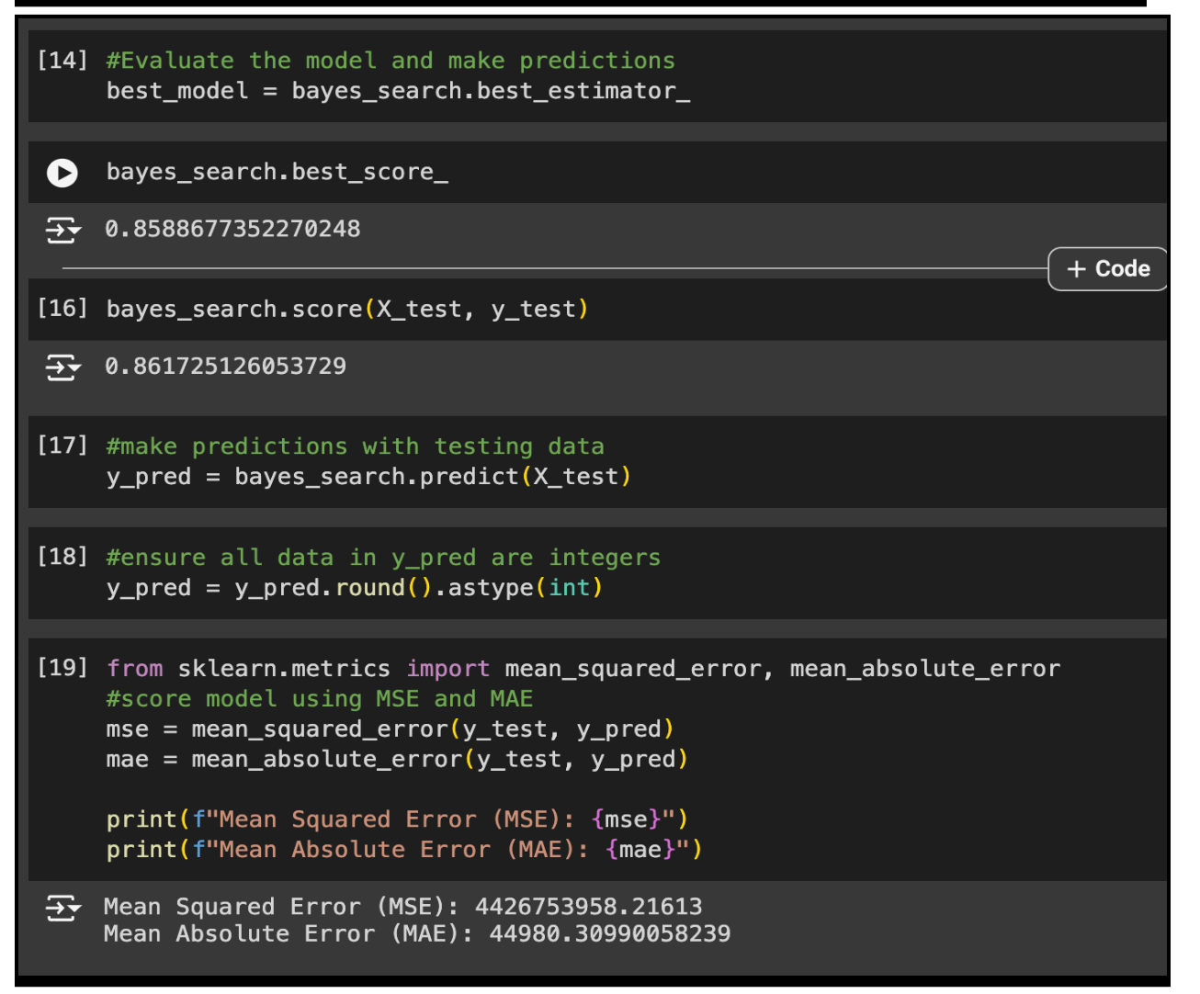
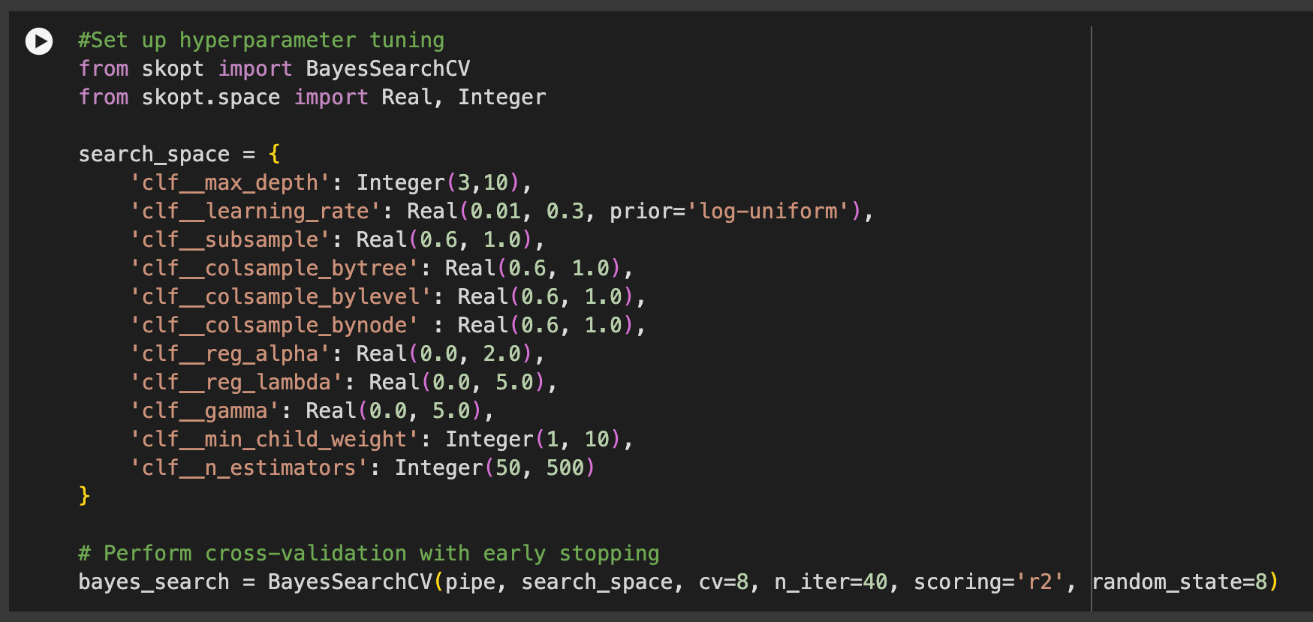
XGBoost 4th round:
Added: ‘n_estimators:Integer (50, 500)’, ‘min_child_weight:Integer (1, 10)’
Adjusted: ‘reg_alpha (0.0, 2.0)’, ‘gamma (0.0, 5.0)’
Adjusted: CV=8, n_iter=40
scoring=r2, added MSE & MAE for testing data

Slide 15
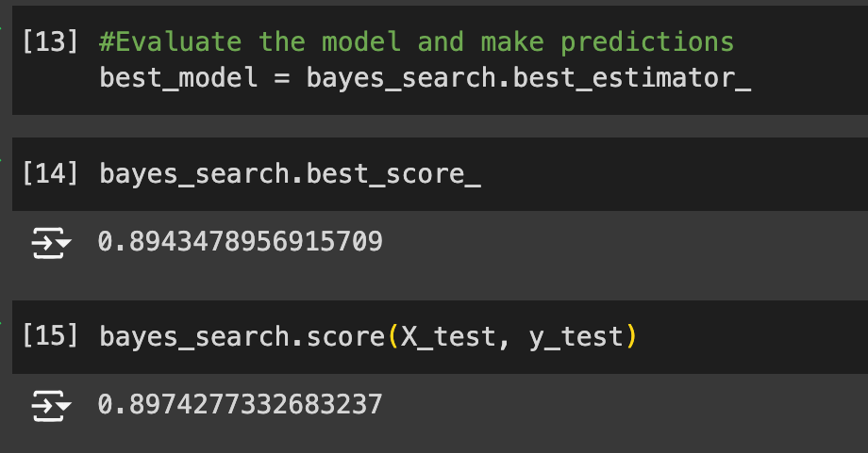
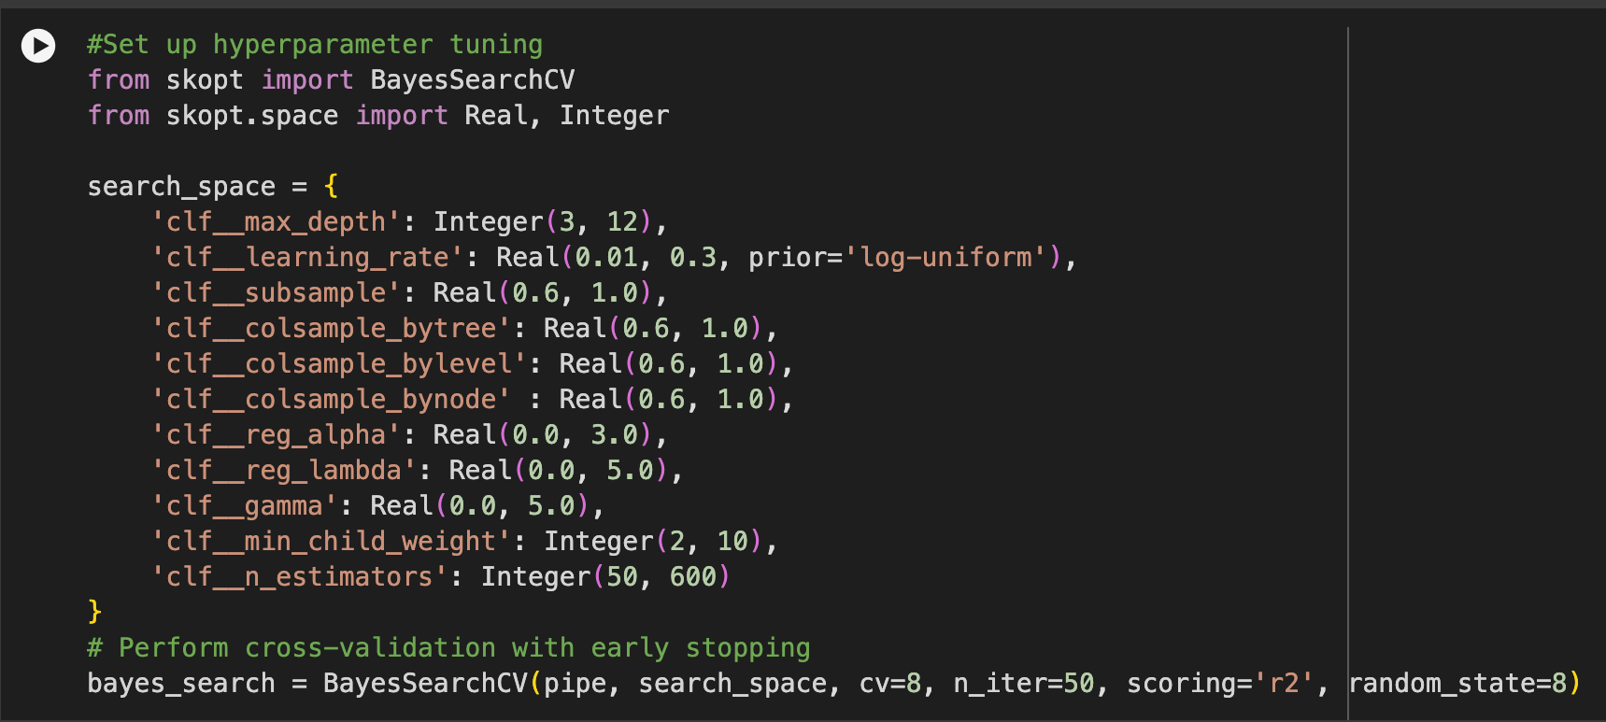
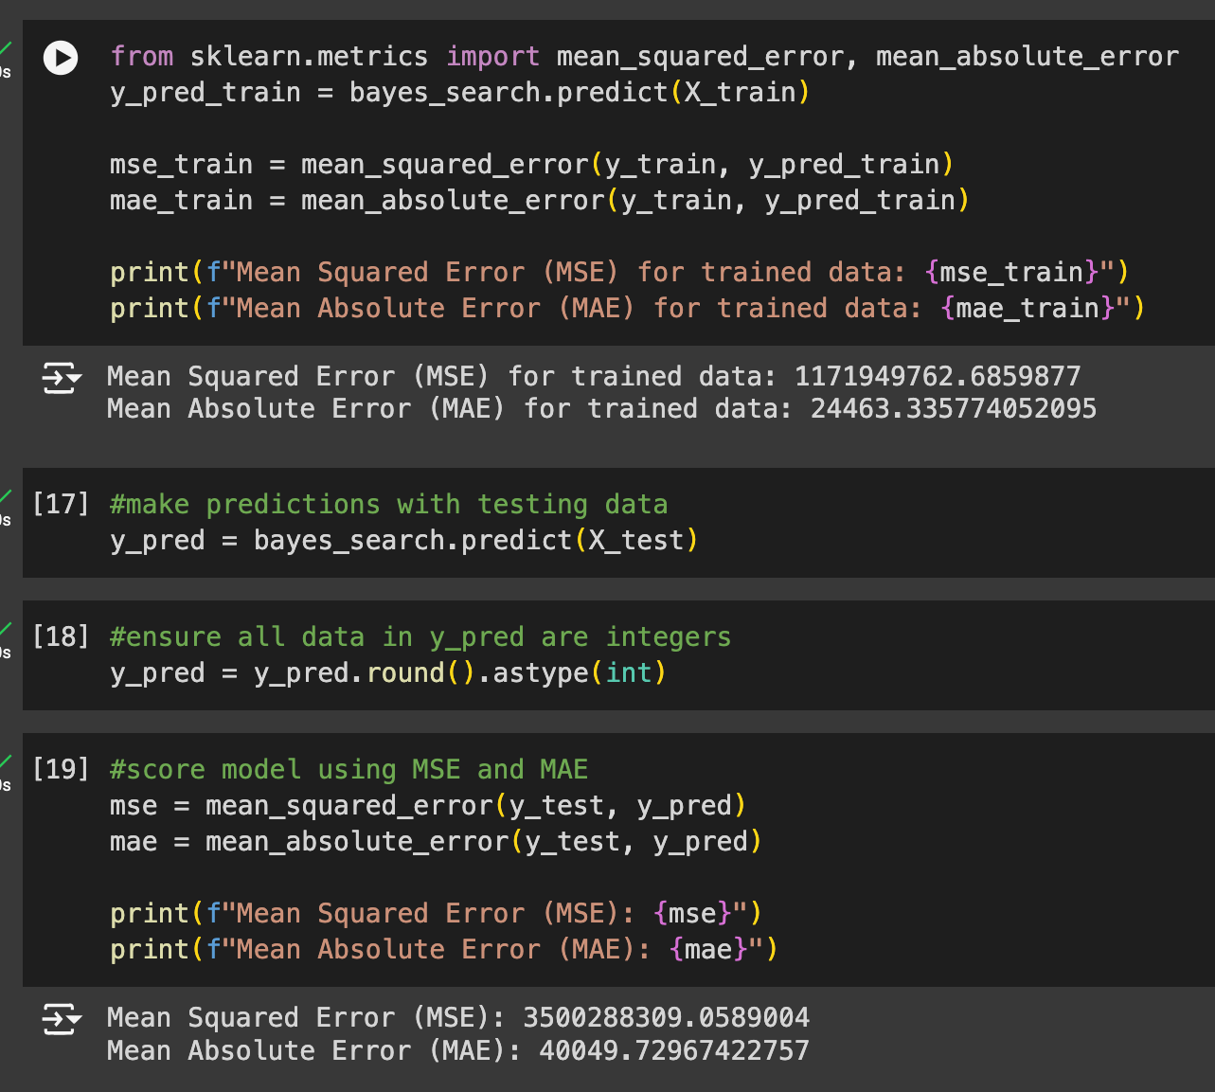
XGBoost 9th round:
Used updated data.
Adjusted 4 of the hyperparameters to accommodate data size & prevent overfitting.
n_iter=50
added MSE & MAE for training data

Slide 16
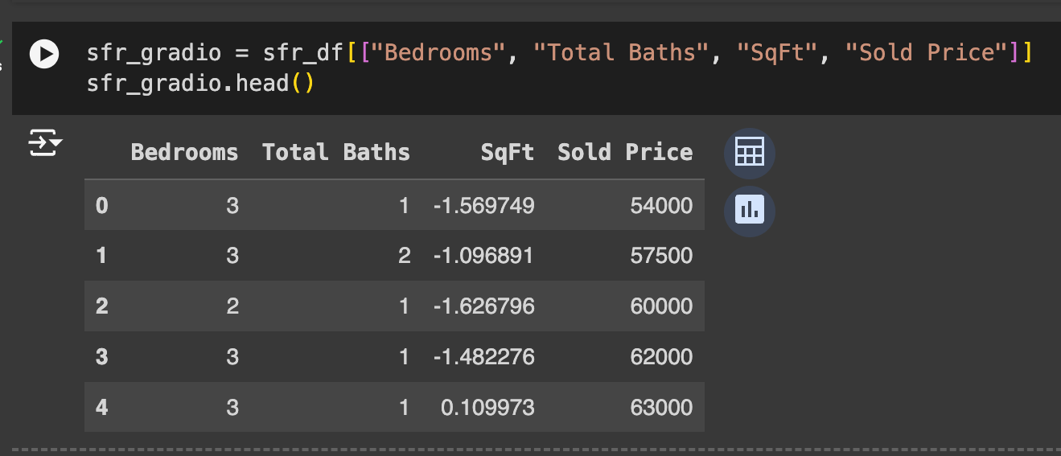
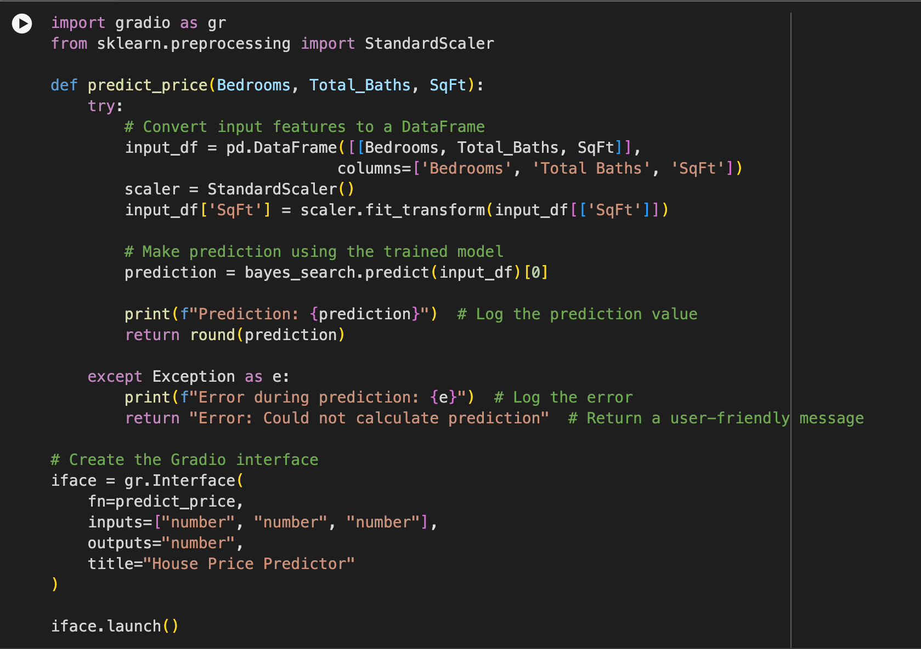
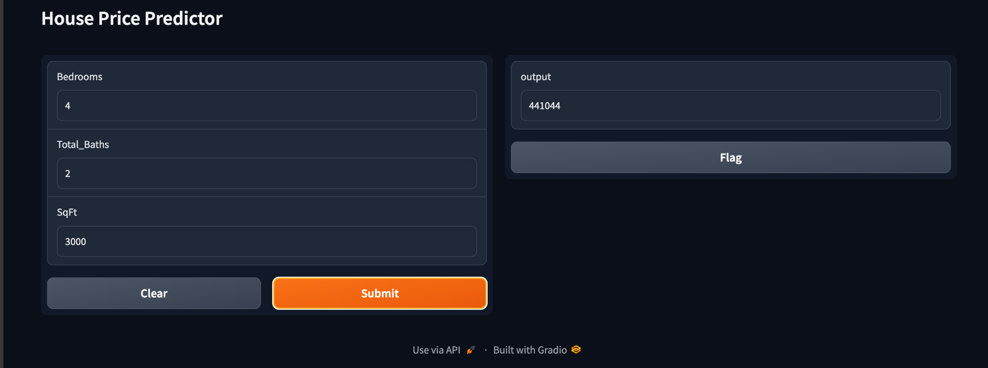
XGBoost Mock Gradio:
Created a new dataframe with only 4 of the features to prepare for a mock gradio interface.
Built a function for gradio using Bedrooms, Total Baths, and Sqft to predict the home price.

Slide 17
Regression:
LightGBM Modules
Notes:
Brandi

Slide 18
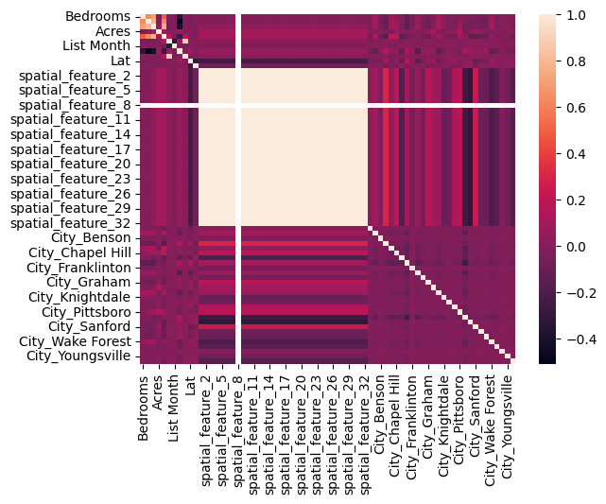
Heatmap

Slide 19
Hyperparameters
# Define LightGBM model
import lightgbm as lgb
lgbm = lgb.LGBMRegressor(objective='regression')
from skopt.space import Real, Integer, Categorical
# defining parameters
params = {
'num_leaves': Integer(20, 50),
'learning_rate': Real(0.01, 0.1, 'log-uniform'),
'n_estimators': Integer(50, 500),
'max_depth': Integer(3, 10),
'metric': Categorical(['l1', 'l2', 'rmse']),
'min_child_samples': Integer(10, 200),
}

Slide 20
X = sfr_df.drop(columns='Sold Price')
y = sfr_df['Sold Price']
X_train, X_test, y_train, y_test = train_test_split(X, y, test_size=0.2, random_state=8)
from skopt.space import Real, Integer, Categorical
# defining parameters
params = {
'num_leaves': Integer(20, 50),
'learning_rate': Real(0.01, 0.1, 'log-uniform'),
'n_estimators': Integer(50, 500),
'max_depth': Integer(3, 10),
'metric': Categorical(['l1', 'l2', 'rmse']),
'min_child_samples': Integer(10, 200),
}

Slide 21
# Make predictions with testing data
y_pred = best_model.predict(X_test)
# Calculate MSE and RMSE, and MAE
mse = mean_squared_error(y_test, y_pred)
mae = mean_absolute_error(y_test, y_pred)
rmse = mse**(0.5)
print("MSE: %.2f" % mse)
print("RMSE: %.2f" % rmse)
print("MAE: %.2f" % mae)
#Train the LightGBM model
bayes_search.fit(X_train, y_train)
#Evaluate the model
best_model = bayes_search.best_estimator_
best_model
bayes_search.score(X_test, y_test)
-3571206253.8192706
MSE: 3571206253.82
RMSE: 59759.57
MAE: 40862.68

Slide 22
NLP (BERT / VADER)
Notes:
Kurt

Slide 23
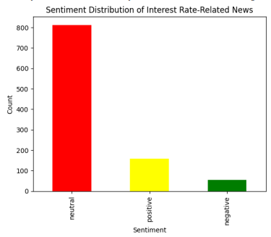
BERT / Pytorch
Notes:
VADER (Valence Aware Dictionary for Sentiment Reasoning) and a BERT-based sentiment classification model differ significantly in terms of their methodology, complexity, and use cases.
1. Methodology:
VADER:
Rule-Based: VADER is a lexicon and rule-based model specifically designed for sentiment analysis. It uses a predefined list of words (lexicon) with associated sentiment scores and applies simple rules to adjust the sentiment scores based on grammar, punctuation, and context.
Predefined Lexicon: VADER assigns sentiment scores based on predefined words and their intensities. For example, words like "great" or "excellent" have positive scores, while "bad" or "terrible" have negative scores.
Lightweight: VADER is computationally light and does not require training or large datasets. It is particularly effective for social media, reviews, or short-form text.
BERT-Based Sentiment Model:
Deep Learning-Based: A BERT-based sentiment model is built on a transformer architecture that uses deep learning to understand the context of words in a sentence. It doesn't rely on predefined lexicons but learns sentiment patterns directly from labeled datasets during training.
Contextual Understanding: BERT excels in understanding the context of words in a sentence, including more complex linguistic nuances like sarcasm, idiomatic expressions, and sentence structure.
Heavyweight: BERT models require more computational resources due to their complexity and need to be fine-tuned on specific tasks, such as sentiment classification.
2. Sentiment Categories:
VADER Categories:
Positive, Negative, Neutral: VADER assigns a sentiment intensity score to a sentence and classifies it into three categories: positive, neutral, or negative.
Compound Score: It also provides a compound score ranging from -1 to 1, representing the overall sentiment of the text, where values closer to -1 indicate negative sentiment and values closer to 1 indicate positive sentiment.
BERT Categories:
Flexible Categories: In a BERT-based model, the number and type of categories are defined by the user during model setup. For example, you could define three classes: positive, negative, and neutral, or you could have more specific categories based on your dataset (e.g., very positive, slightly positive, etc.).
Customizable Labels: You can customize the categories based on the specific sentiment task you are working on by fine-tuning the model on labeled data.
3. Complexity and Accuracy:
VADER:
Simple: VADER works well on simple, short texts where sentiment is straightforward (e.g., tweets, comments, reviews).
Limited Context Understanding: VADER struggles with complex sentence structures, sarcasm, or idiomatic expressions, as it relies on predefined words and rules.
No Training Required: VADER can be used out-of-the-box and doesn't require any model training or large datasets.
BERT-Based Model:
Advanced: BERT is designed for more complex sentiment analysis, capable of understanding context, word relationships, and nuances within a sentence.
Contextual Understanding: BERT handles longer and more complex texts better, making it more suitable for tasks like analyzing news articles, long reviews, or documents with intricate language.
Training Required: BERT needs to be fine-tuned on a specific dataset, which can be resource-intensive but yields more accurate results in complex tasks.
4. Use Cases:
VADER:
Best for short, social media-like texts such as tweets, comments, and customer reviews.
Suitable for real-time applications where quick sentiment analysis is required with minimal computational resources.
Can be applied in scenarios where high precision and nuance are less critical.
BERT-Based Sentiment Model:
Best for complex documents, such as news articles, legal documents, or product reviews, where context and subtlety in language are important.
Suitable for tasks requiring high accuracy in sentiment classification, especially in cases where the text is longer and more intricate.
Ideal for domains requiring fine-tuned sentiment detection (e.g., finance, healthcare, etc.).
Example Comparison:
VADER Example**: "The movie was not bad."
VADER might classify this as negative or neutral because of the presence of the word "bad", even though the sentence conveys a positive sentiment.
BERT Example: "The movie was not bad."
BERT would likely classify this as positive because it can better understand the context and recognize that "not bad" implies a positive sentiment.
Conclusion:
VADER is simpler, faster, and effective for shorter, less complex texts but may struggle with nuanced sentiment or longer documents. It's good for quick, rule-based sentiment classification without much resource overhead.
BERT offers more powerful, context-aware sentiment analysis for complex texts, but it requires more computational resources and needs to be fine-tuned on a labeled dataset.
In your case of analyzing interest rate-related news articles, a BERT-based model would likely provide more accurate and nuanced results due to the complexity of financial language and the need to understand subtle sentiment variations.
How to optimize BERT?
Compare BERT and VADER.
New version of GPT available - Continue ch

Slide 24
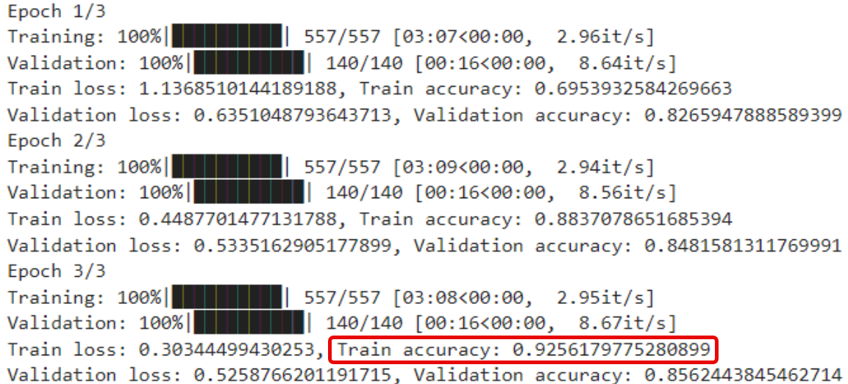
BERT / Pytorch
3 Epochs utilized to improve model accuracy, over fitting noted after Epoch 3.
Notes:
Importance of Epochs in Training:
Improving Model Accuracy:
Training across multiple epochs allows the model to learn patterns from the data incrementally. After each epoch, the model's parameters are updated to minimize the loss function (the difference between the predicted and actual outcomes).
With more epochs, the model becomes more accurate because it has more opportunities to adjust its weights based on the feedback from the data.
Avoiding Underfitting:
Underfitting occurs when the model does not learn enough from the data and performs poorly on both training and testing sets.
Training for more epochs helps the model capture the underlying patterns in the data, thus reducing the chances of underfitting.
Balancing Overfitting and Generalization:
Overfitting happens when a model learns too much from the training data and performs well on the training set but poorly on unseen data (test set).
Monitoring the model’s performance across epochs (e.g., using validation data) helps in finding the right balance: stopping training when the model starts overfitting, and continuing until the model generalizes well.

Slide 25
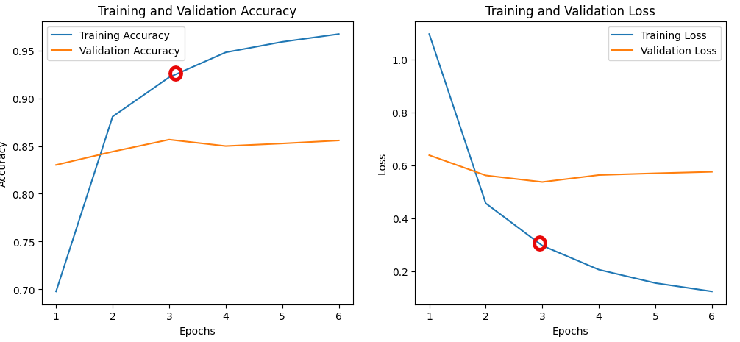
BERT / Pytorch
Notes:
Overfitting: The consistent decrease in training loss and near-perfect accuracy on the training data, combined with an increasing validation loss and stagnating validation accuracy after Epoch 3, suggests that the model is overfitting the training data.
Validation Plateau: When the validation accuracy plateaus or decreases while the training accuracy continues to improve, it indicates that the model is learning specific details of the training data that do not generalize well to new, unseen data. This is a sign of overtraining.

Slide 26
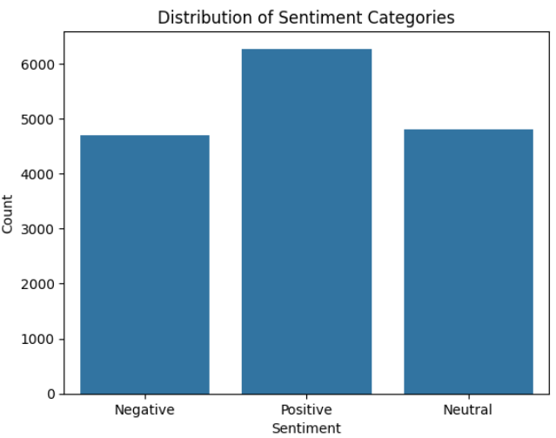
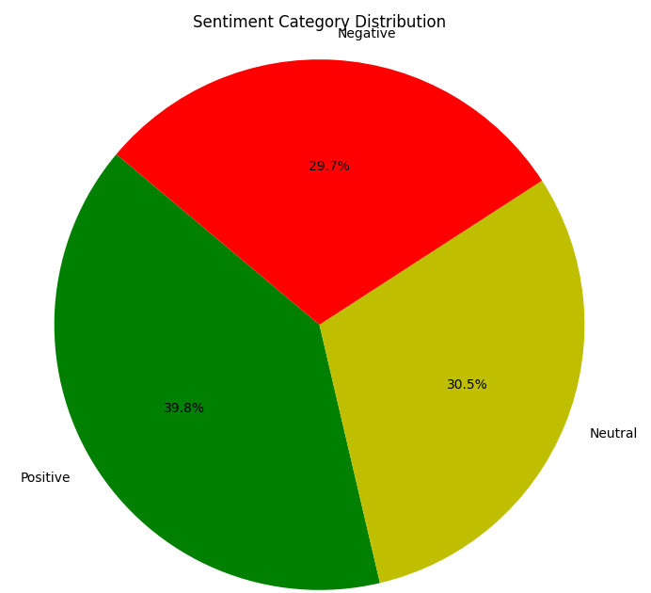
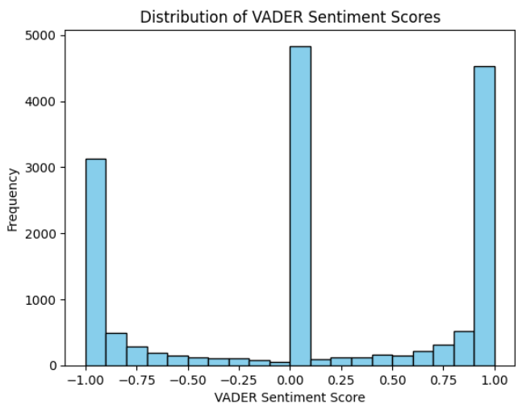
VADER - Sentiment Analysis
Notes:
Positve 39.8, 29.7 Negative, 30.5

Slide 27
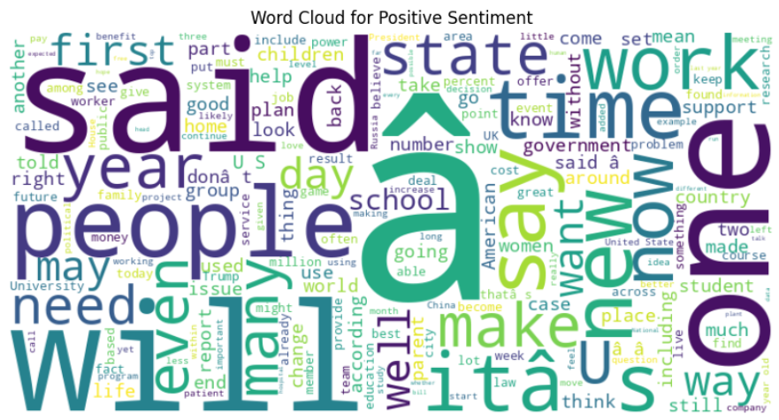
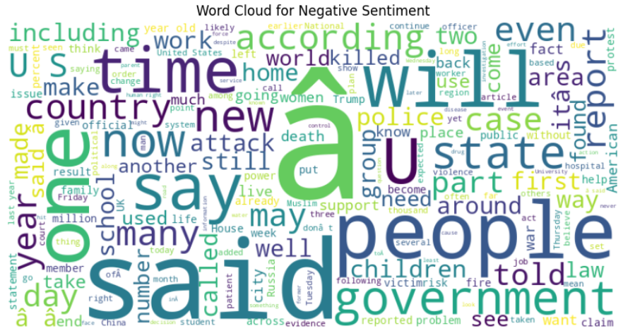
VADER - Word Cloud
Word clouds provide a broad overview of the most common terms associated with positive and negative sentiments, they also highlight the complexities and nuances of language that can cause certain words to appear in both categories, example, “said”, “people”, “state”.
Notes:
Word Cloud Analysis Summary for Presentation
The word clouds for positive and negative sentiments reveal an interesting overlap of certain words. This overlap can be attributed to the complex nature of language, where the same words can convey both positive and negative sentiments depending on the context in which they are used. For example:
Contextual Usage: Many words are context-dependent. A word like "strong" might be positive in some contexts ("strong support") and negative in others ("strong resistance"). This is why such words may appear in both word clouds.
Ambiguity in Language: Some words carry neutral or ambiguous meanings that can shift based on their surrounding phrases. For instance, a word like "unbelievable" can signify positive events ("unbelievable achievement") or negative outcomes ("unbelievable disaster").
Negation and Sentiment: The presence of negations, like "not good" or "not bad," can also cause positive words to appear in negative contexts and vice versa. VADER's handling of negation may capture the sentiment but not perfectly reflect it in the word clouds, which are generated based on frequency rather than context.
Word Frequency-Based Clouds: Word clouds are created based on word frequency, so even if a word contributes to both positive and negative sentiments in different articles, its frequent appearance will cause it to show up in both clouds.
In summary, while the word clouds provide a broad overview of the most common terms associated with positive and negative sentiments, they also highlight the complexities and nuances of language that can cause certain words to appear in both categories.

Slide 28
Conclusions
 | R2 Train | R2 Test | MSE Train | MSE Test | MAE Train | MAE Test
Random Forest | 0.982 | 0.869 | 6.16E8 | 4.45E9 | 16505 | 44392
XGBoost |  | 0.897 | 1.17E9 | 3.50E9 | 24463 | 40050
CatBoost | 0.886 | 0.857 | 3.89E9 | 4.69E9 | 44004 | 47602
LightGBM |  | 59760 |  | 3.57E9 |  | 40863
XGBoost tends to perform best with the test data and overfits less than the Random Forest model, but still overfits significantly
CatBoost seems to overfit the least, yet still produce a reasonable mean absolute error
Notes:
David

Slide 29
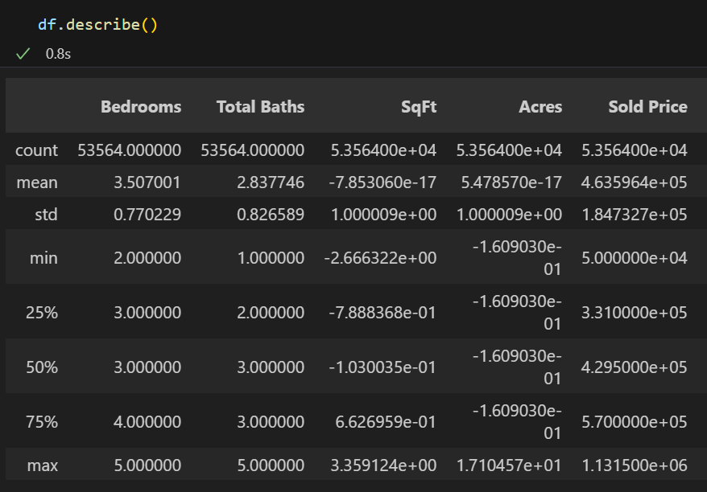
Conclusions
Sale prices for dataset range from 50k to 1.13 million
Median home price for the data set is roughly 460k
Based on these numbers, we have roughly an 8.6% error with XGBoost and 10.3% for CatBoost
Most sites like Zillow and Redfin have an error of ~8%
Notes:
David

Slide 30
NLP Conclusions
BERT (Bidirectional Encoder Representations from Transformers) and VADER ( Valence Aware Dictionary for Sentiment Reasoning) models indicate positive article sentiment.
BERT model provide more accurate and nuanced results due to the complexity of financial language and the need to understand subtle sentiment variations whereas VADER works well on simple, short texts where sentiment is straightforward.
BERT overfitting noted after Epoch 3, training accuracy of 92%
Larger data set specific to keywords needed.
Notes:
David

Slide 31
Improvements / Changes
Include other spatial features like scalars and geohashes alongside existing features
Find a way to improve overfitting on tree models
Create pipeline to take in any given address via Gradio, scale data, and perform Lat/Lon conversion to predict home value
Incorporate more features alongside NLP sentiment to predict future mortgage rates
NLP sentiment on database
Create UI, package these items together, alongside others, to sell to real estate investors as investment tool

Slide 32
Questions?

Slide 33
Thank You!

